Slide 1
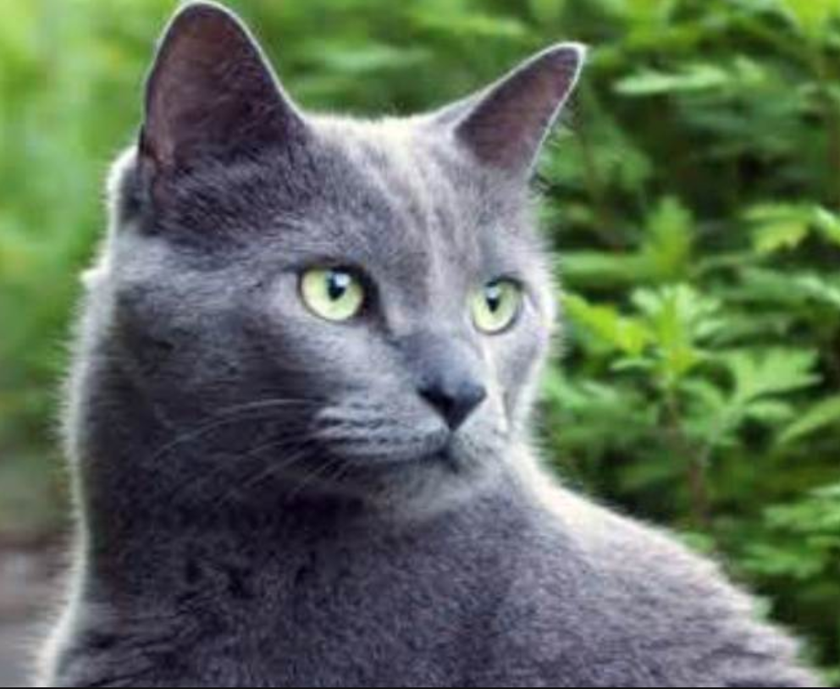
CNN Assisted Transcription: CAT
Raphael Taiwo Alabi Ph.D
October 2nd, 2018
Notes:
Convolutional Neural Network assisted transcription (CAT) with Russian language as a case study ……………………

Slide 2
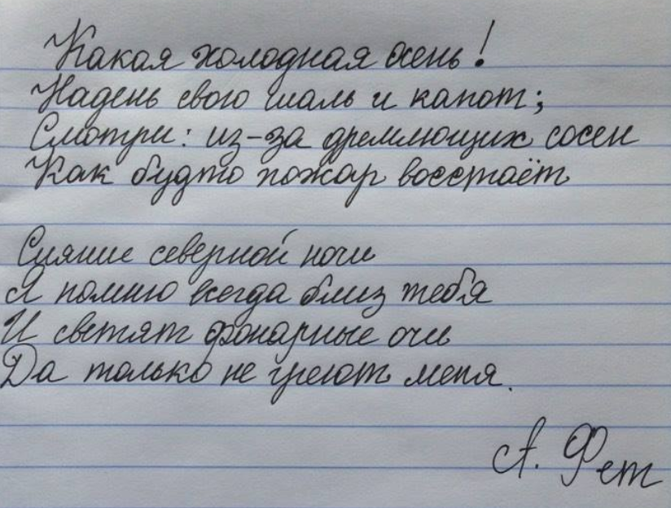
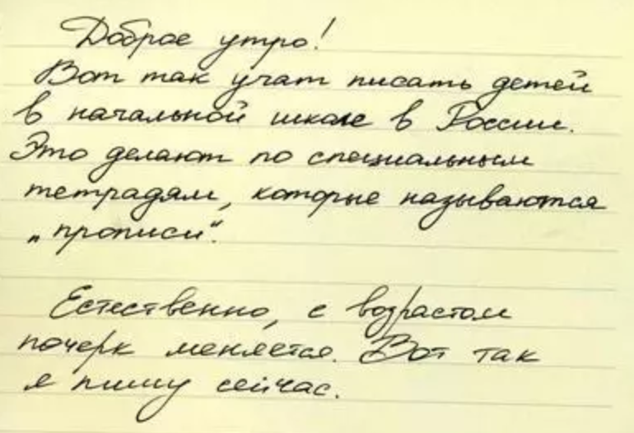
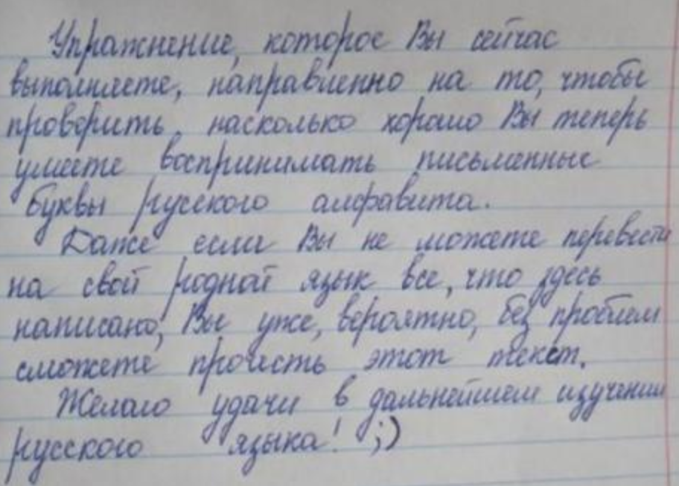
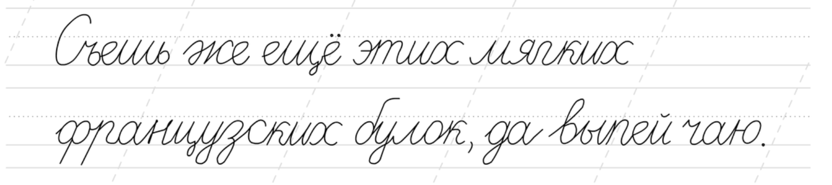
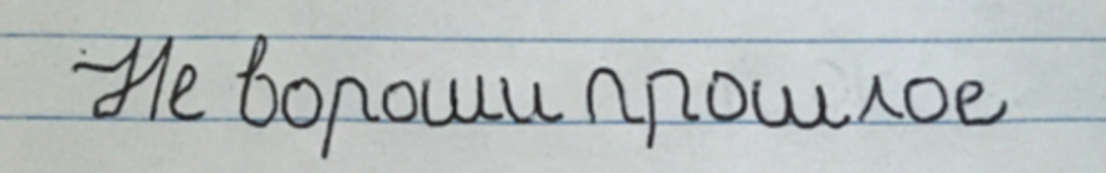
Problem Statement and Motivation:
Language transcription still mainly manual – Done by humans!
Notes:
Language transcription is still mostly a manual labor with human transcription of language at around 96% accuracy.
Language transcription is even more of a challenge for languages such as Russian language where the cursive nature of the language presents a huge barrier
For transcription.
The advent of Convolutional neural networks with ability to identify complex shapes and figures with high accuracy can be explored for transcription of such difficult languages such as
Russian language.
Russian language is chosen as frame work for this since it represents the extreme end of the spectrum of difficulty with alphabets flowing cursively one into another.
Transcription has uses not only in medical fields and for legal purposes but also use in our everyday lives for information retrieval and archiving.
(Reduce the text) – Challenges in Language Transcription………….
(Make sure to explain the meaning of jargons on slides or remove the jargons if not needed)
The medical transcription market alone is $41.4 billion and the legal transcription market is likely similar if not more…………….

Slide 3
Problem Statement and Motivation:
Language transcription more difficult for cursive handwriting
Notes:
Language transcription is still mostly a manual labor with human transcription of language at around 96% accuracy.
Language transcription is even more of a challenge for languages such as Russian language where the cursive nature of the language presents a huge barrier
For transcription.
The advent of Convolutional neural networks with ability to identify complex shapes and figures with high accuracy can be explored for transcription of such difficult languages such as
Russian language.
Russian language is chosen as frame work for this since it represents the extreme end of the spectrum of difficulty with alphabets flowing cursively one into another.
Transcription has uses not only in medical fields and for legal purposes but also use in our everyday lives for information retrieval and archiving.
(Reduce the text) – Challenges in Language Transcription………….
(Make sure to explain the meaning of jargons on slides or remove the jargons if not needed)
The medical transcription market alone is $41.4 billion and the legal transcription market is likely similar if not more…………….

Slide 4
Problem Statement and Motivation:
Transcription has uses in legal, medical. for Info. Retrieval
Notes:
Language transcription is still mostly a manual labor with human transcription of language at around 96% accuracy.
Language transcription is even more of a challenge for languages such as Russian language where the cursive nature of the language presents a huge barrier
For transcription.
The advent of Convolutional neural networks with ability to identify complex shapes and figures with high accuracy can be explored for transcription of such difficult languages such as
Russian language.
Russian language is chosen as frame work for this since it represents the extreme end of the spectrum of difficulty with alphabets flowing cursively one into another.
Transcription has uses not only in medical fields and for legal purposes but also use in our everyday lives for information retrieval and archiving.
(Reduce the text) – Challenges in Language Transcription………….
(Make sure to explain the meaning of jargons on slides or remove the jargons if not needed)
The medical transcription market alone is $41.4 billion and the legal transcription market is likely similar if not more…………….

Slide 5

Market Size:

Slide 6
Demo:
_{http://127.0.0.1:5000/}

Slide 7

Novel Grid-Search Transcription:
Init:
predict
Iter-1:
predict
Notes:
Break it down to Checking to see the blanck spaces
Checking to see the individual alphabets
Checking to characterize the individual alphabets

Slide 8
Novel Grid-Search Transcription:
Iter-1:
Iter-2:
predict
Iter-3:
predict
Notes:
Break it down to Checking to see the blanck spaces
Checking to see the individual alphabets
Checking to characterize the individual alphabets

Slide 9
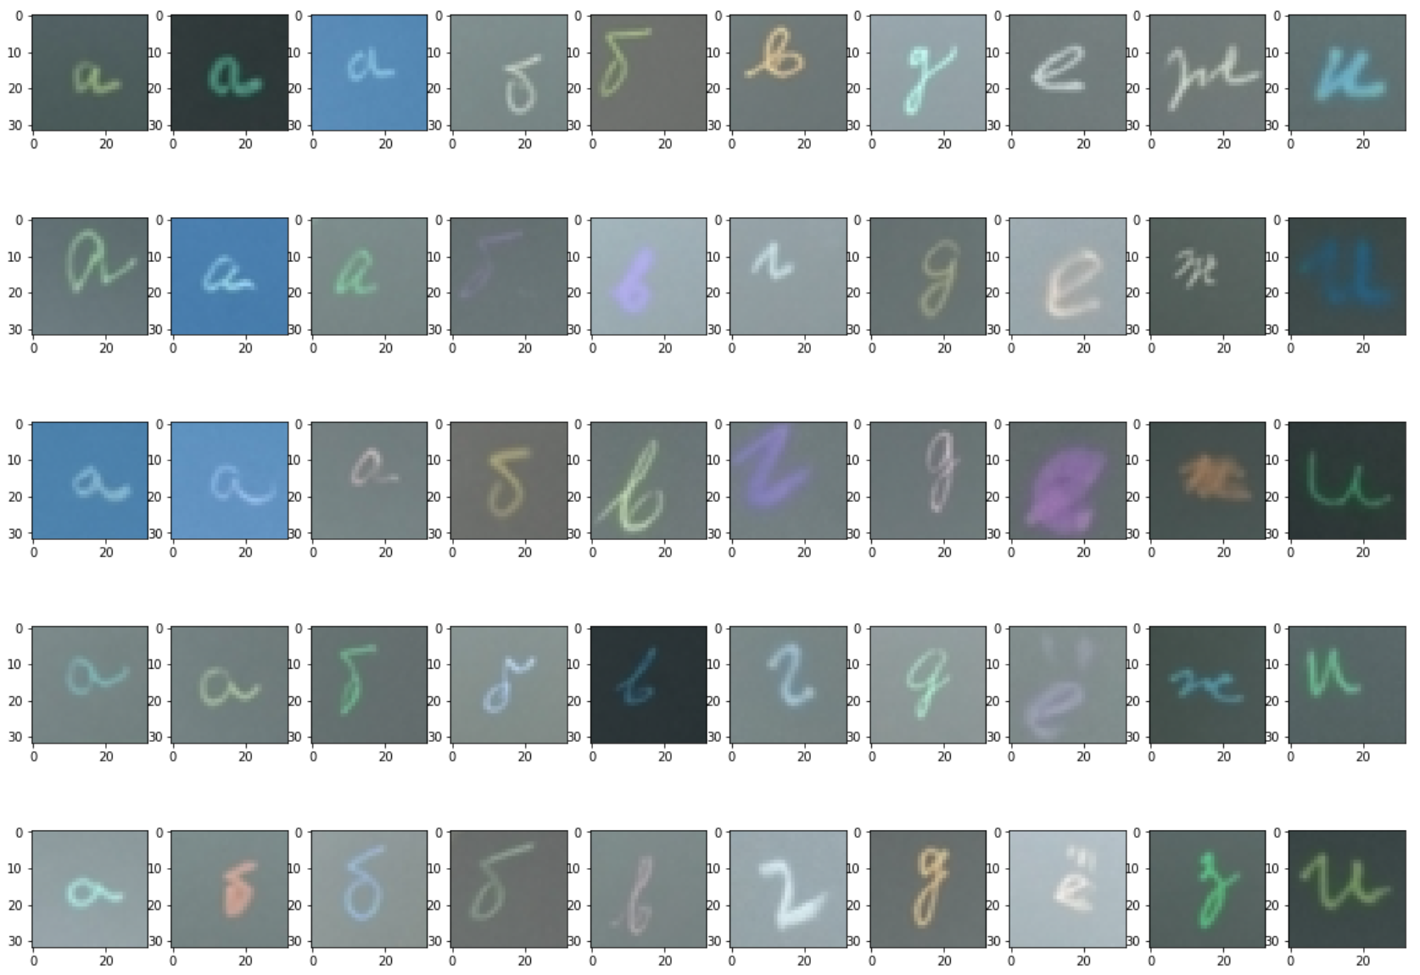
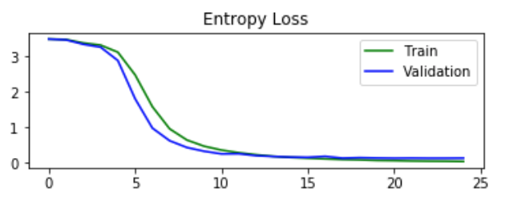
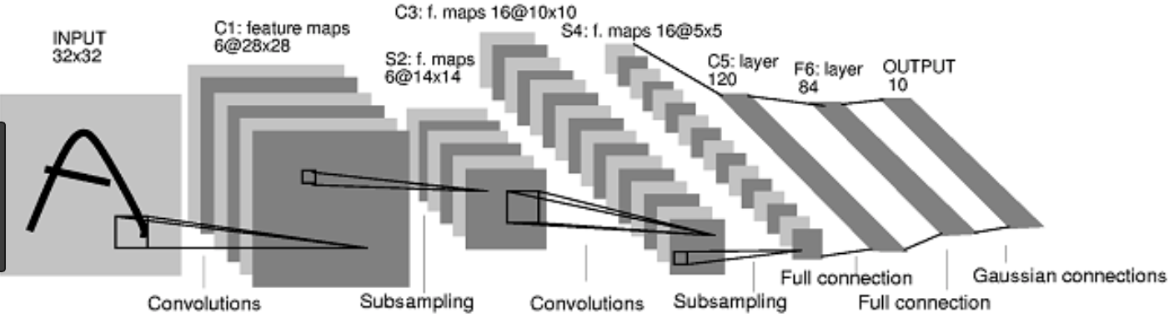
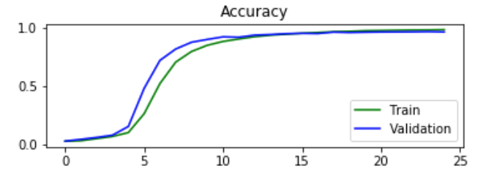
Data Exploration and Methodology:
4 Convolution layers
3 fully connected deep layers
97% alphabets ~30% on words
Custom built CNN architecture
Notes:
By building a Convolutional Neural Network trained on written Russian alphabets one can build a ground truth baseline.
There has been quite some work done with MNIST dataset for alphabet, number recognition for latin alphabeths and Arabic numerals but not a lot of work has been done on Cyrillic russian alphabets.
This research project builds upon existing frameworks in latin alphabeth recognition by developing a custom convolutional neural network for Russian alphabet recognition.
The variety of the dataset available shows a diversity in both writing style as well as background.
By using the alphabeth recognition capability of CNN Russian word detection can be seen as a grid search technique………
The classification of words in Russian language can then be seen as a grid-search technique that uses the

Slide 10
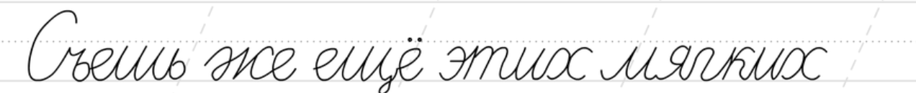
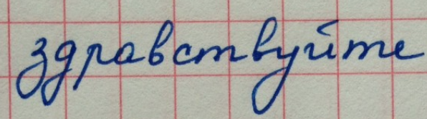
Summary
Russian language is indeed a difficult problem …
Individual character transcription ~97% matches MNIST
Much worse on word transcription –
Hidden Markov Models….
Use dictionary post word-filtering….

Slide 11






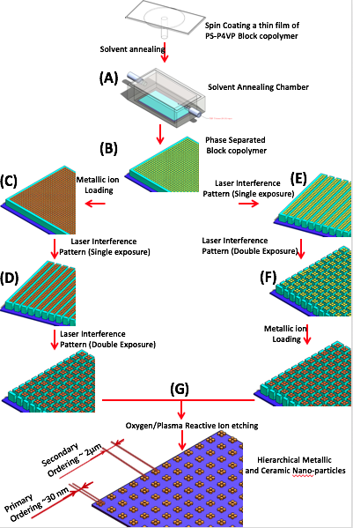
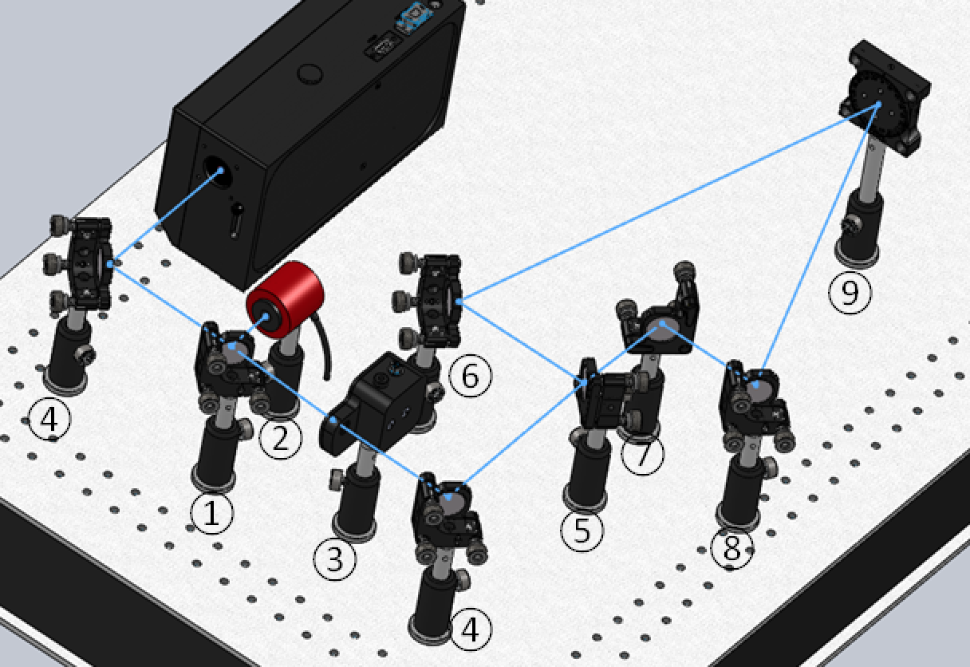
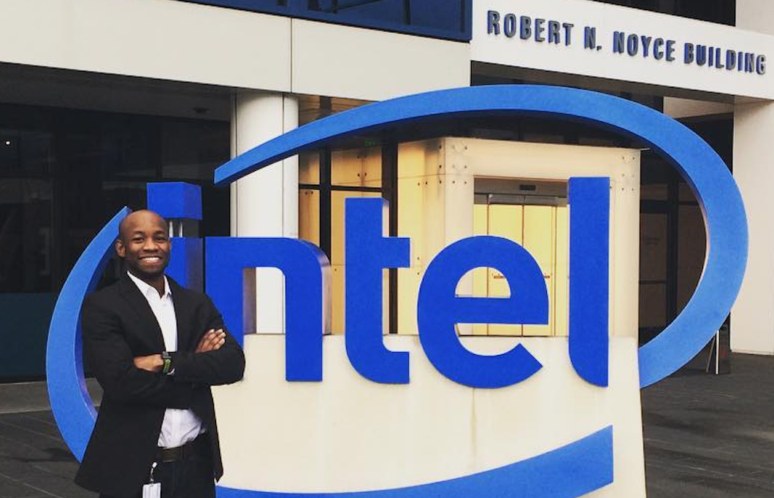
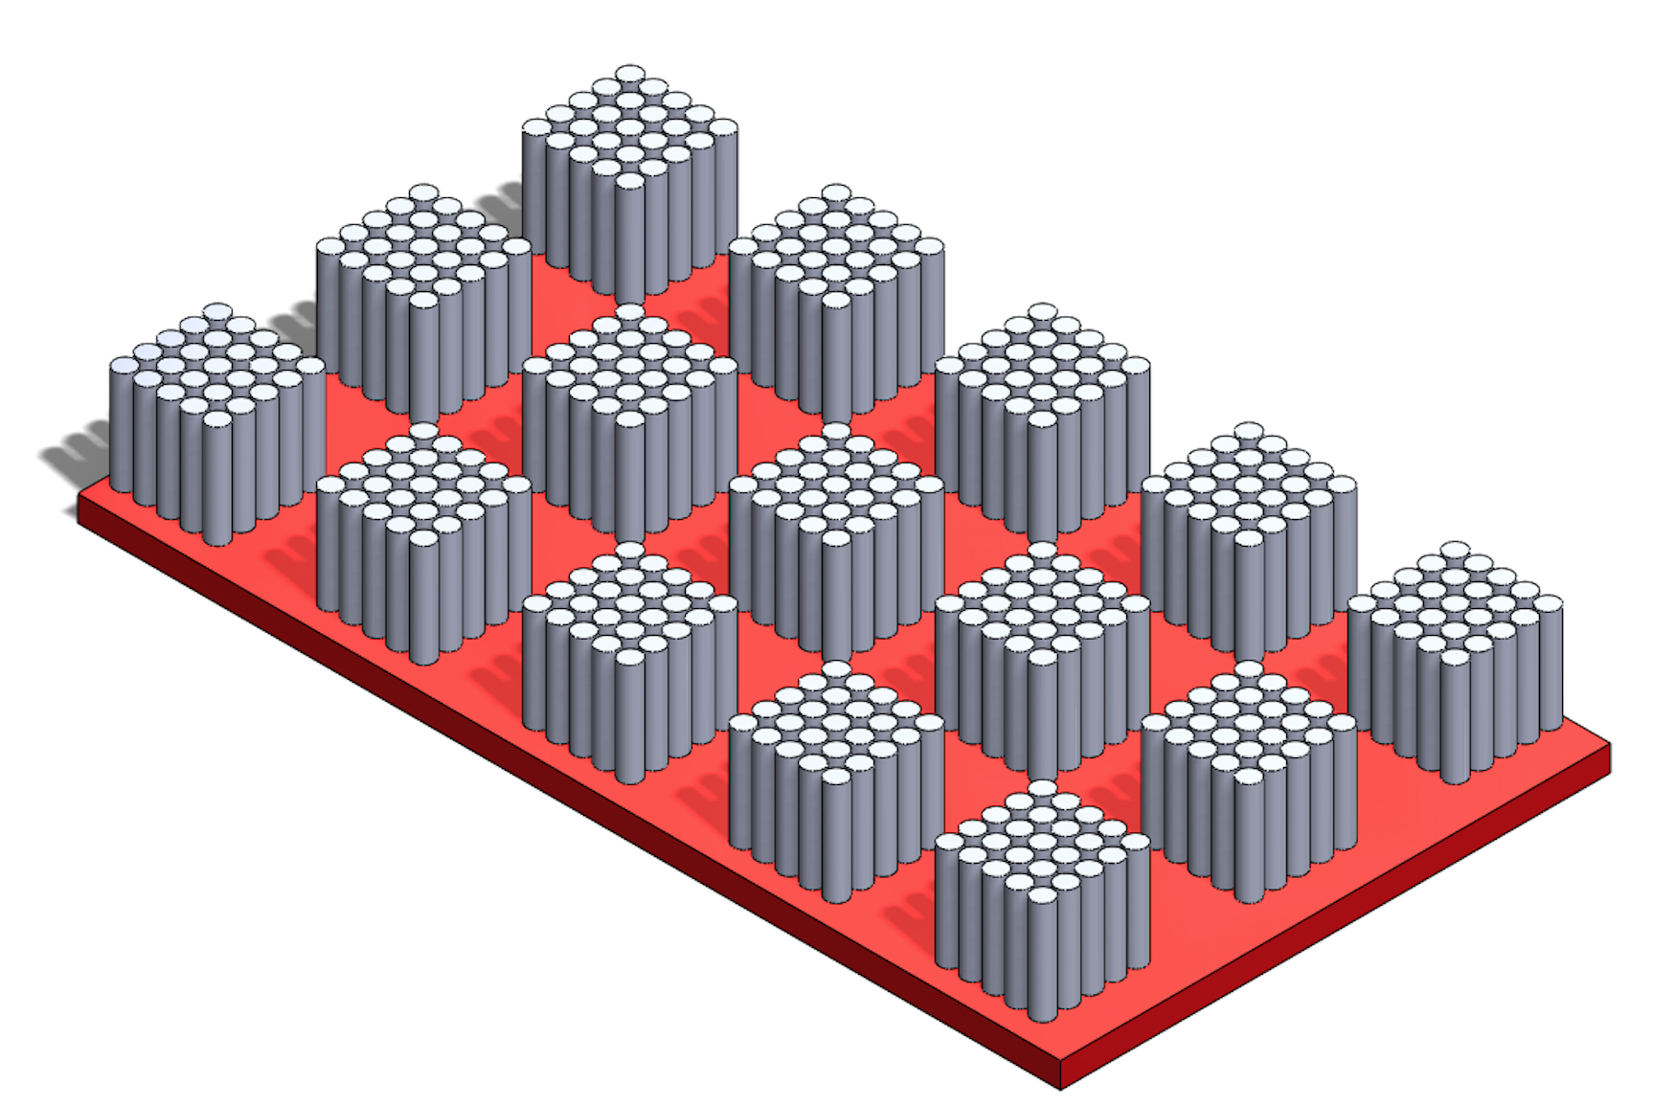
Raphael Taiwo Alabi Ph.D
Work for Intel Corp.
Georgia Tech Ph.D
UC Berkeley Masters MIDs
Running, Spartan Races,
Ultimate frisbee, basketball,
Extreme hiking {Mt. Everest soon!}
Notes:
My name is Raphael Taiwo Alabi and I got my PhD from Georgia Tech and a Masters degree in data-science from UC Berkeley and I currently work for Intel Corporation!
Thank You!!!

Slide 12
Back-Up Slides

Slide 13
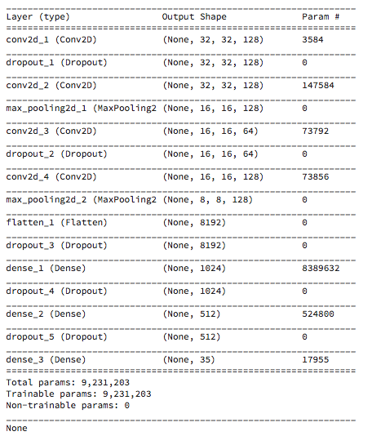

Slide 14
Handwritten alphabets differ greatly from typed alphabets.
Language is beautiful but written language can be “Ugly”
Russian language – dear to my heart, cursive and can be
beautifully written but extremely difficult to understand
Transcription still mostly manual even on English language
Most historic literatures are hand -written and
the need for transcription is ever so important.
Convolutional Neural Networks to the rescue!

Slide 15
Model Improvement
Low accuracy can be significantly improved with Grid-search with feed-back loop to grid definition
First alphabet can be used as an anchor for generating grid patterns around potential alphabet edges
Max_arg probability can span over 1 or 2 previously recognized alphabets (Hidden Markov Models)

